Slide 1
Ultracold Project Summary
April 23, 2021

Slide 2
Work done so far
Refactored the original code to a python package.
A GAN network for predictive MTF denoising.
An interactive MTF visualization tool.

Slide 3
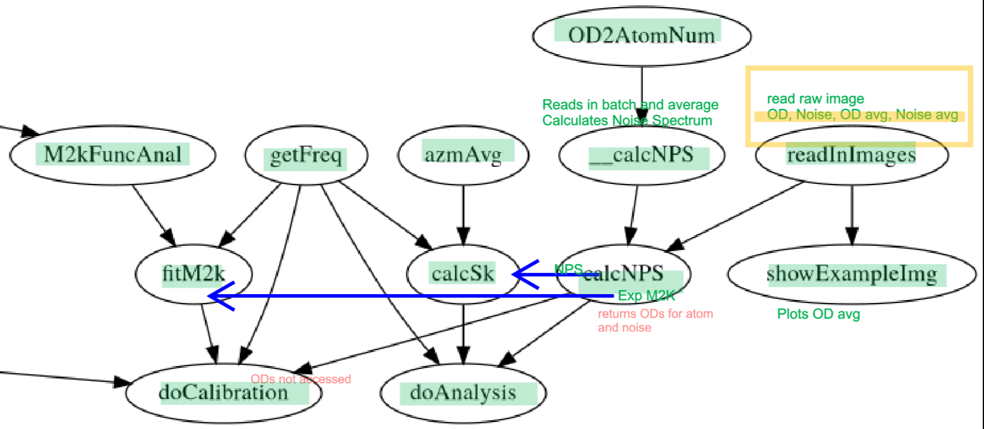
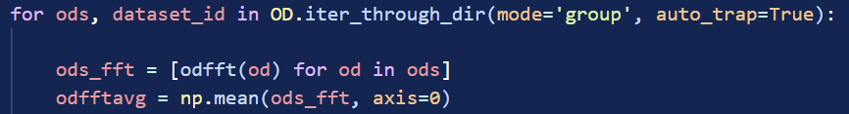
The UltraCold package
Simplified code
Improved Code Style, Easy Reuse
Fully Documented and Commented
Efficient query and labeling of the whole database
Call graph of original code
Using the current code to extract OD trap regions from all available datasets
Can upload to pypi to be easily used in future

Slide 4
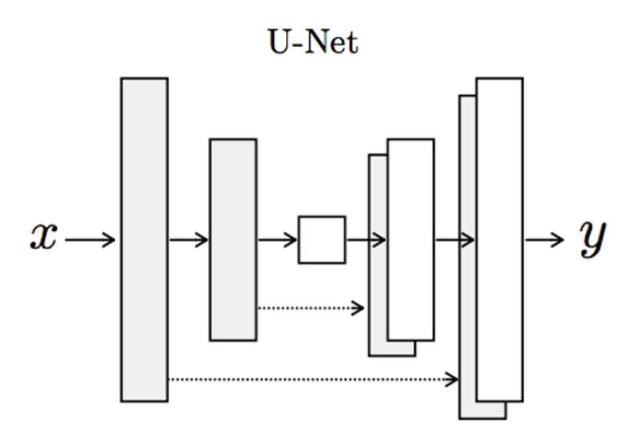
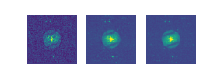
The Generative Denoiser
Trained on single OD FFT – mean OD FFT pairs.
Limit: small training batch, not prone to fringe patterns. Hard to measure quantitatively.
Future Improvement:
Use MTF generated by fitting result as ground truth (prone to error)
Transfer Learning from denoiser
Data Augmentation through noise adding and rotation
Data Generation for whole parameter domain
Architecture of
Image Autoencoder
Prediction Example
Predicted OD Mean
Single OD
OD mean

Slide 5
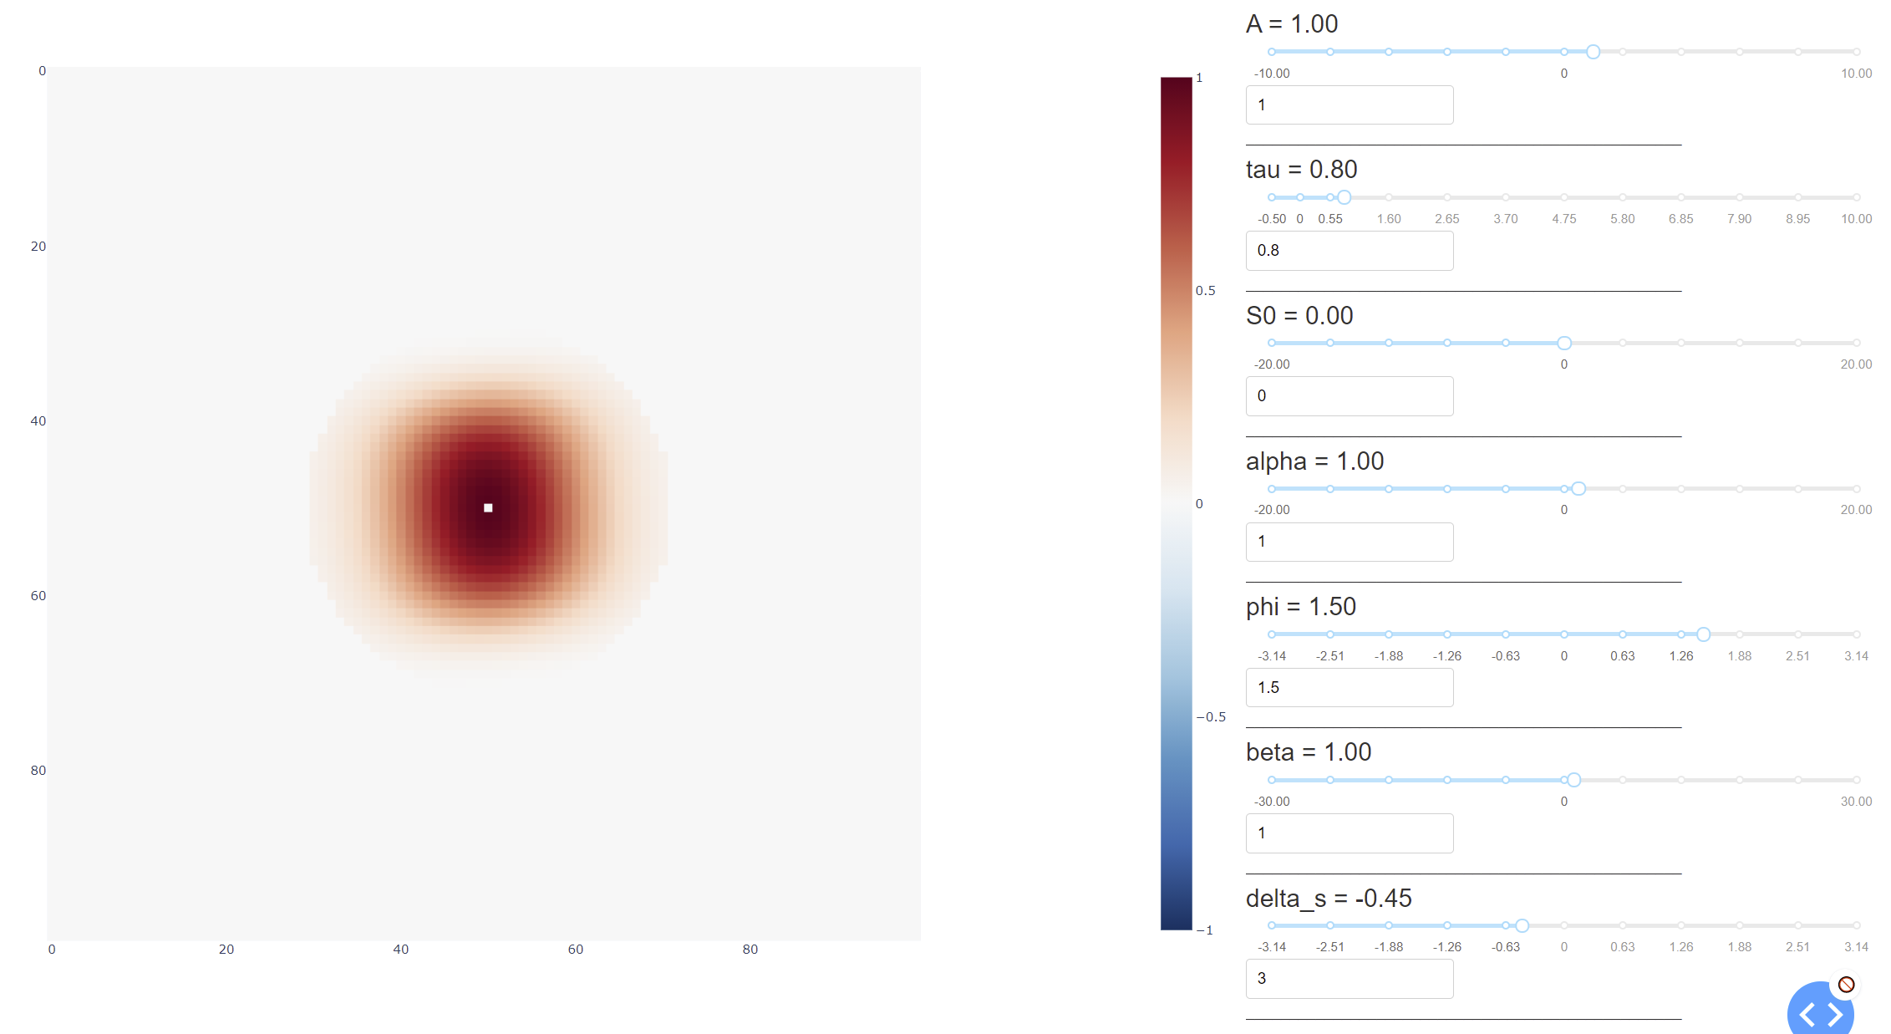
Interactive MTF Playground
Helps to intuitively understand the parameters
Support interactive fitting in future, as a learning tool

Slide 6
A more formal description to the problem

Slide 7
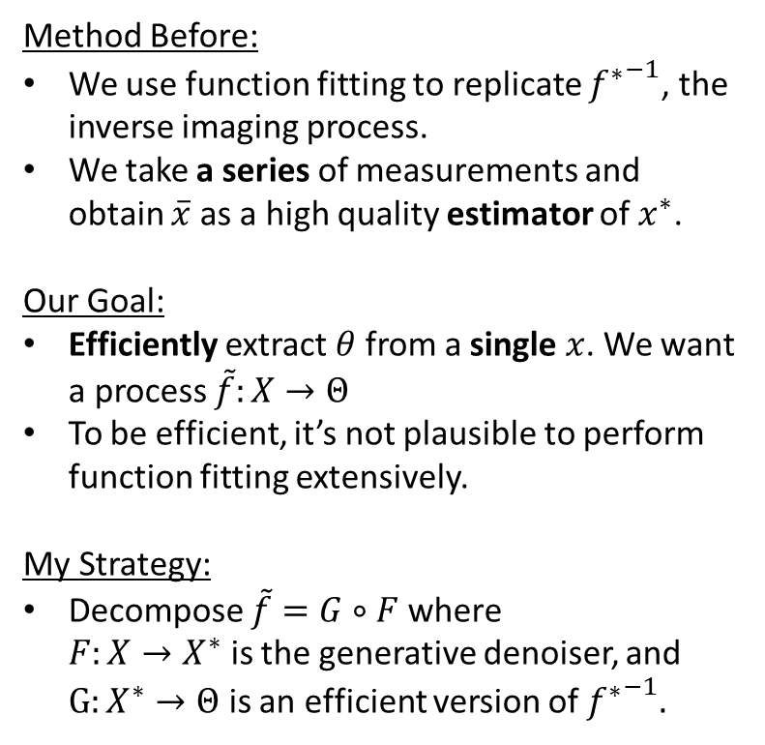
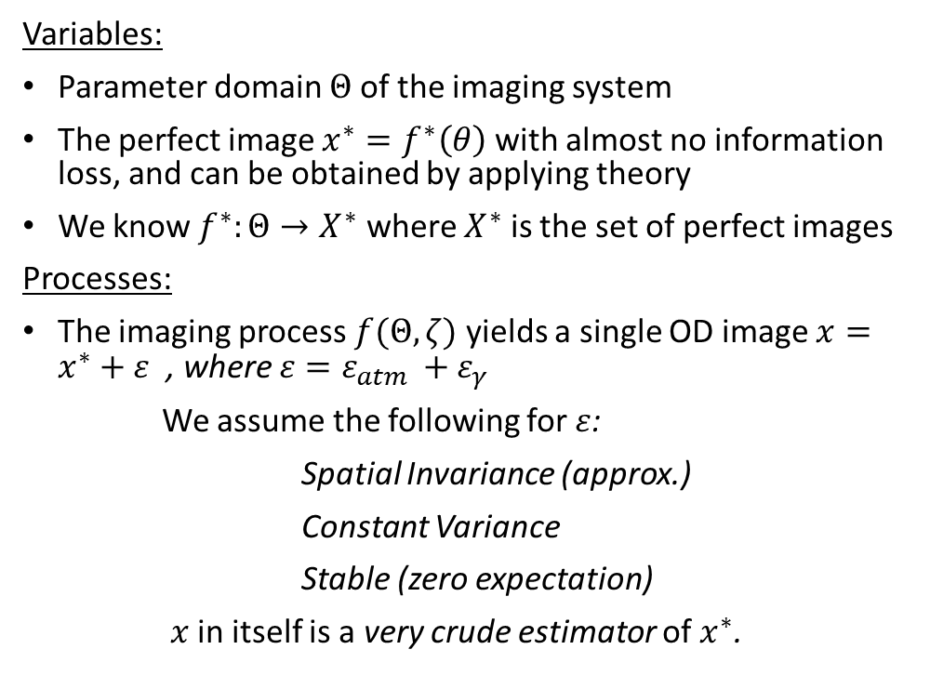
Problem Statement
Method Before:
We use function fitting to replicate ${f^{∗}}^{−1}$, the inverse imaging process.
We take a series of measurements and obtain $\overline{x}$ as a high quality estimator of $x^{∗}$.
Our Goal:
Efficiently extract $θ$ from a single $x$. We want a process $\tilde{f}:X→Θ$
To be efficient, it’s not plausible to perform function fitting extensively.
My Strategy:
Decompose $\tilde{f}=G∘F$where $F:X→X^{∗}$ is the generative denoiser, and $G:X^{∗}→Θ$ is an efficient version of ${f^{∗}}^{−1}.$
Variables:
Parameter domain $Θ$ of the imaging system
The perfect image $x^{∗}=f^{∗}\left(θ\right)$ with almost no information loss, and can be obtained by applying theory
We know $f^{∗}:Θ→X^{∗}$ where $X^{∗}$ is the set of perfect images
Processes:
The imaging process $f(Θ, ζ)$ yields a single OD image $x=x^{∗}+ε$, where $ε=ε_{atm }+ε_{γ}$
We assume the following for $ε$:
Spatial Invariance (approx.)
Constant Variance
Stable (zero expectation)
$x$ in itself is a very crude estimator of $x^{∗}$.

Slide 8
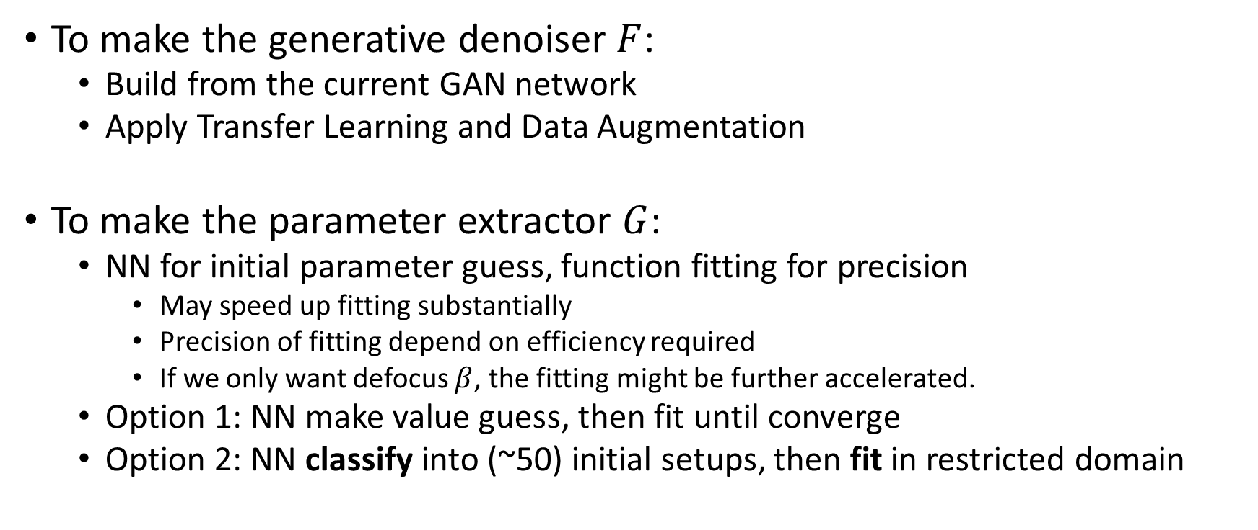
Next Steps
To make the generative denoiser $F$:
Build from the current GAN network
Apply Transfer Learning and Data Augmentation
To make the parameter extractor $G$:
NN for initial parameter guess, function fitting for precision
May speed up fitting substantially
Precision of fitting depend on efficiency required
If we only want defocus $β$, the fitting might be further accelerated.
Option 1: NN make value guess, then fit until converge
Option 2: NN classify into (~50) initial setups, then fit in restricted domain

Slide 9
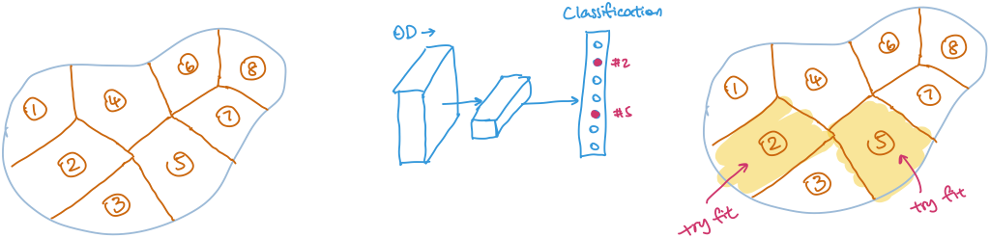
Illustration to the PPP strategy
Partition the parameter domain
Pick from partitions. The kernel is the first parameter estimate.
Precise estimate obtained from function fitting.

Slide 10
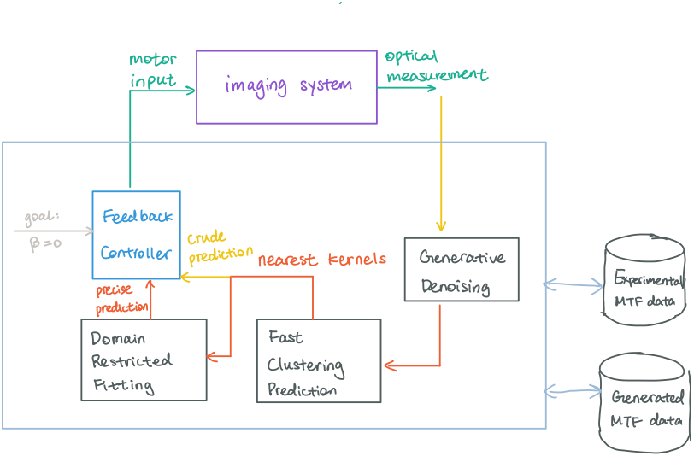
The System Structure

Slide 11
Development Roadmap
Production Available Sep-Oct
(test on campus)
Working Demo 5/15
Ensemble Testing
And Validation 7/1
Working Demo 6/1

